Slide 1

IT4103
Web Programming
Week 7 Server side programming
PHP Scripting Language
MySQL Database
Apache Server

Slide 2
Server-side Scripting
Server-side scripting is a web server technology in which a user's request is fulfilled by running a script directly on the Web server to generate dynamic HTML pages.
Server-side scripting enables the ability to highly customize the response based on the user's requirements, access rights, or queries into data stores.

Slide 3
Server Side Web Technologies
  PHP
  ASP (Active Server Pages) & ASP.NET
  JSP (Java Server Pages)
  Java Servlets
  C++/Java
  PERL
  XML

Slide 4
Introduction to PHP
Originally stood for Personal home Page, now Hypertext Preprocessor
Html embedded scripting language, Which makes developing dynamic websites more accessible
A server side scripting language (every thing does in the server)
Cross platform technology / Platform Independent (runs on most OS)

Slide 5
Introduction to PHP
Better faster and easier to learn, powerful, popular
Design to something only after and event occurs
Ex. When user submit a form goes to URL
Supports many DB’s (not only MySQL, Informix, Oracle, Sybase, Solid, PostgreSQL, Generic ODBC )

Slide 6
Introduction to PHP
Web Server Independent
Free and Open Source
      no warranty, no limits on usage
      Source code is available for any modifications
      Freely Extended (must share source, represent original works and owners)
      License is not specific to a product or restrict other software and also technology neutral.

Slide 7
What’s so Great About PHP?
PHP runs on different platforms (or cross platform) such as Windows, Linux, Unix, etc.
PHP is compatible with almost all servers used today (Apache, IIS and any other web server that support the CGI standard)
PHP is FREE to download from the official PHP resource: www.php.net
PHP is easy to learn and runs efficiently on the server side

Slide 8
How does PHP works?
A typical PHP page will contain number of PHP elements along with HTML markup elements and other textual content
When a web browser request a PHP page from a web server that is PHP enabled the server will call up the PHP parser to process all the PHP elements on that page
The PHP parser executes the PHP script instructions on the page ,generating a HTML document that is then sent to the web browser as a response to the original request
The PHP parser may also be asked to retrieve information from a database so the entire process appears like the illustration bellow

Slide 9
How does PHP works?
<html>
<body>
Text content
<?php ….. ?>
</body>
</html>
Server
PHP parser
response
<html>
<body>
Text content
Dynamic PHP content here
</body>
</html>
request
Databases

Slide 10
Creating a PHP environment?
In order to develop and run PHP web pages following three components need to be installed on the computer system
Web server
    Internet Information Server (IIS)
    Apache server
Database
    Oracle
    MySQL
PHP parser

Slide 11
What do you need?
Download PHP for free here: http://www.php.net/downloads.php
Download MySQL for free here: http://www.mysql.com/downloads/index.html
Download Apache for free here: http://httpd.apache.org/download.cgi

Slide 12
Installing Apache
At first remove IIS , Start settings control panel add or remove programs click add/remove windows components if the IIS tick on , disable and stop it.
Double click on apache setup and install it your computer.
  Give any domain name e.g.. anyname.com
  Give any server name e.g. www.anyname.com

Slide 13
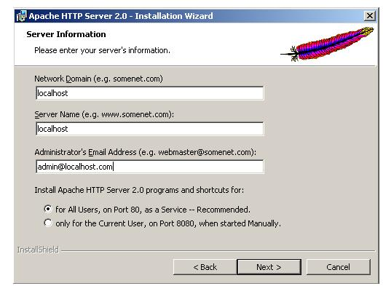
Installing Apache

Slide 14
Installing PHP
PHP zip(php 5.x) file must be extracted ,using any zip file tool like winzip, to convenient location , like C:\PHP or copy the extracted file and paste it to the C:\ root directory , then rename as PHP
In this PHP folder there is a text file called “install.txt” which has all the details about how to install php and other php related softwares .
Also there are two files called
  php.ini-dist
  php.ini-recommended
  Copy one of these file to C:\Apache2 and rename it as “php.ini”

Slide 15
Installing PHP cont.
Go to conf folder in apache2 folder and open httpd.txt file and paste following lines in the top of the file .
LoadModule php5_module C:/php/php5apache2.dll
AddType application/x-httpd-php .php
Stop the web server and restart it.

Slide 16
Testing PHP
Take notepad and write following code
<?php phpinfo(); ?> save this as follows in the web server
Save as c:\ windows\ apache\ hotdocs\ info.php
Access Internet Explorer and type http:\\localhost\info.php (display information about php.ini)

Slide 17
What is MySQL?
MySQL is a database server
MySQL is ideal for both small and large applications
MySQL supports standard SQL
MySQL compiles on a number of platforms
MySQL is free to download and use

Slide 18


PHP + MySQL
PHP combined with MySQL are cross-platform (you can develop in Windows and serve on a Unix platform)

Slide 19
Configuring of MySQL in PHP
Double click on php.ini file and see windows extensions uncomment php-mysql.dill line.
Copy php-mysql.dill file in ext folder in php folder and paste in php folder.
Copy libmysql.dill and php-mysql.dill and paste it in windows\system32
If mysql not working restart the web server.

Slide 20
Apache benefit
Apache is well supported - Apache is free and available 24 hours a day via Internet
Apache is multi-platform - Apache can run on virtually any hardware platform (from PCs to mainframes), and almost any operating system, such as Linux, Windows etc.
Apache is secure - security holes are rare but when they exist they are discovered and fixed quickly
Apache is extensible - anyone can write modules that easily plug in to Apache. anyone with programming skills can write the modules you need.
Apache is database-friendly - you can interface Apache with virtually any commercial database, such as Oracle, Sybase, DB2, and Informix, as well as free databases such as MySQL and Postgres.
Apache is hardware-friendly - Apache generally consumes far fewer hardware resources that commercial web servers.
No Microsoft Viruses - Apache is immune viruses that target at Microsoft Web servers.

Slide 21
MySQL benefit
One of the most used open source database in the world.
Capacity to handle 50,000,000+ records.
Very fast command execution, perhaps the fastest to be found on the market
Flexible and secure password system to protect your data - powerful security system
Fast, reliable, easy to use,
On-line help facility
Comes with a source code
Multi-User and works on Several Platforms

Slide 22
Three in together…
Easy to install
No Manual configuration
E.g
  WAMP server
  XAMPP

Slide 23
What is a PHP File?
PHP files can contain text, HTML tags and scripts
PHP files are returned to the browser as plain HTML
PHP files have a file extension of ".php", ".php3", or ".phtml"

Slide 24
Basic PHP Syntax
A PHP scripting block always starts with <?php and ends with ?>. A PHP scripting block can be placed anywhere in the document.
E.g.
<?php
some cording
?>
On servers with shorthand support enabled you can start a scripting block with <? and end with ?>.
Start Tag
End Tag

Slide 25
Say “Hello World!” using PHP
A PHP file normally contains HTML tags, just like an HTML file, and some PHP scripting code.
<html>
<body>
<?php
echo “Hello World!”;
?>
</body>
</html>
Each code line in PHP must be ended with a semicolon
Notes:
Each code line in PHP must end with a semicolon. The semicolon is a separator and is used to distinguish one set of instructions from another.

Slide 26
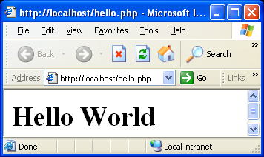
Simple PHP program
Type this code in any text editor and save it as hello.php in Apache’s htdocs folder
  <html>
  <?php echo ("<h1>Hello World</h1>"); ?>
  </html>
Open internet Explorer and write http:\\localhost\hello.php in address bar
OUTPUT

Slide 27
Output a Text in PHP
There are two basic statements to output text with PHP
echo
print
In the example above we have used the echo statement to output the text "Hello World".
Also you can use print as bellow
<?php print “Hello World!”; ?>
Notes:
The file must have a .php extension. If the file has a .html extension, the PHP code will not be executed.

Slide 28
Comments in PHP
In PHP there are two types of comments
Single-line
  // or # to make a single line comment
Large comment block
  /* and */ to make a large comment block
<?php
//This is a comment
# This is a Comment
/*
This is
a comment
block
*/
?>

Slide 29
Variables in PHP
Variables are creating by adding “$“ to the front of a name.
$variable name
e.g. $result , $text, $num
Variable name is case sensitive
Semicolon is used to end the php statement
    $a=5;
    $n=7.7;
php will determined the data type at the time data is assign to a each variable.
Notes:
Normally variables have defined types, such as integer or string; but PHP automatically changes the type when needed.

Slide 30
String Variables in PHP
String variables are used for values that contains characters.
A string can be used directly in a function or it can be stored in a variable.
<?php
$txt = "Hello World";
echo $txt;
?>
Notes:
The concatenation operator (.) is used to put two string values together.
The strlen() function is used to return the length of a string.
<?php
echo strlen("Hello world!");
?>
The strpos() function is used to search for character within a string.
<?php
echo strpos("Hello world!","world");
?>

Slide 31
Variables in PHP
Variable names can be of any length
can include letters, numbers and underscores
cannot start with a digit
case-sensitive
can have the same name as a function.

Slide 32
Variable cont.
A variable can represent another variable's name
$a = "Mark";
$$a = "Jones";
$a = "Mickey";
$$a = "Brown";
echo $Mark; // Jones
echo $Mickey; // Brown
echo $$a; // Brown
$a = "Mark";
echo $$a; // Jones

Slide 33
Simple programs
(1)
<?php
$a=7;
echo “$a”;
?>
(2)
<?php
$name=“saman”
echo $name;
?>

Slide 34
Exercise
Write a php program to display your name , address, birthday and school.

Slide 35
Answer
<?php
$name="Sarath";
$address="kegalle";
$birth="1981/10/30";
echo $name;
echo "<br/>";
echo $address;
echo "<br/>";
echo $birth;
?>

Slide 36
Data types
Eight standard data types available in php
Type | Example | Keyword
Boolean | True/false | bool
Integer | 5 | integer
Float or Double | 5.767 | double
string | “saman” | string
object | an instance of class
Array | Array of values
Resource | database
Null | Un initialized variable

Slide 37
Data types cont.
To assign values to variables:
    $foo = ‘bar’; Data Type: String
    $foo = 1; Data Type: integer
    $foo = 5.34; Data Type: Double
    $foo = array(“bar”,”united”); Data Type: Array
Data Types are automatically assigned though you can force a data type by type casting. For example:
    $foo = ‘Hello’;
    $bar = (int)$foo;
    $bar now equals 0
Almost all variables are local. Global include $_POST
Array in php
$names[0] = 'Helen';
$names[1] = 'Susan';
$names[2] = 'Marc';

Slide 38
gettype()
You can used the building php function called gettype() to test the type of variable.
If you place a variable between the parenthesis of the function called gettype() returns a string representing the relevant type.

Slide 39
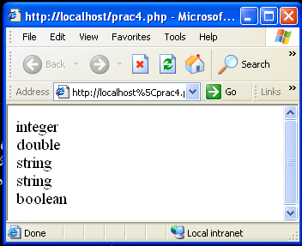
gettype()
<html>
<body>
<?PHP
$varint=12;
$vardouble=12.12;
$varstring1="test";
$varstring2='test';
$varbool=true;
echo gettype($varint),"<br>";
echo gettype($vardouble),"<br>";
echo gettype($varstring1),"<br>";
echo gettype($varstring2),"<br>";
echo gettype($varbool),"<br>";
?>
</body>
</html>

Slide 40
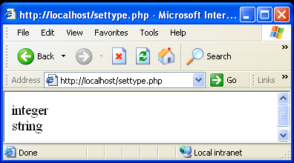
Settype()
<?php
$ccc=7;
echo gettype($ccc);
settype($ccc,'string');
echo "<br/>";
echo gettype($ccc);
?>

Slide 41
PHP Operators
There are lists of different operators used in PHP
Arithmetic Operators (e.g. =, +=, *=)
Assignment Operators (e.g. +, -, *)
Comparison Operators (e.g. <, >, >=, ==)
Logical Operators (e.g. !, &&, ||)

Slide 42
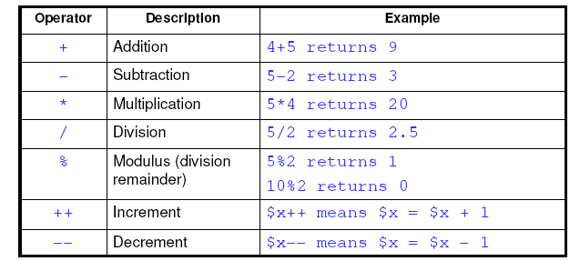
Arithmetic Operators
Arithmetic operators take numerical values (either literals or variables) as their operands and return a single numerical value.

Slide 43
Exercise
Write a php program to add two values and print the final result.

Slide 44
Answer
<?php
$a=7;
$b=8;
$c=$a+$b;
echo $c;
?>

Slide 45
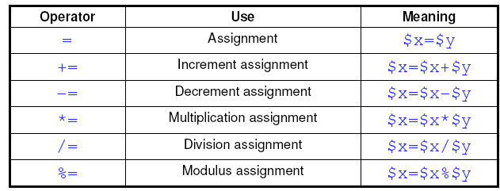
Assignment Operators
An assignment operator assigns a value to its left operand based on the value of its right operand.

Slide 46
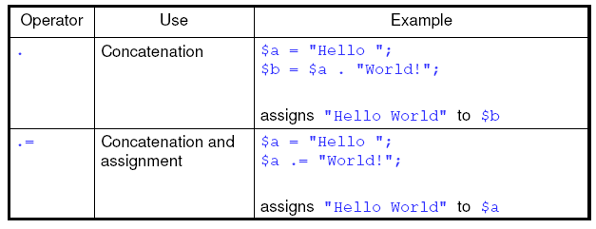
String Operators
PHP has two string operators:

Slide 47
Exercise
e.g.
<?php
$fname=“sarath” ;
$lname=“perera”;
$full=$fname .= $lname;
echo $full;
?>
Answer is sarath perera

Slide 48
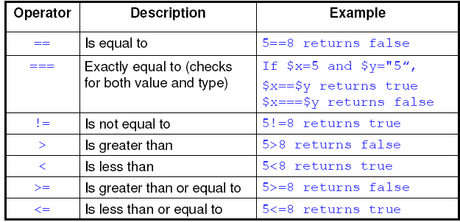
Comparison Operators
A comparison operator compares its operands and returns a logical value based on whether the comparison is true or not

Slide 49
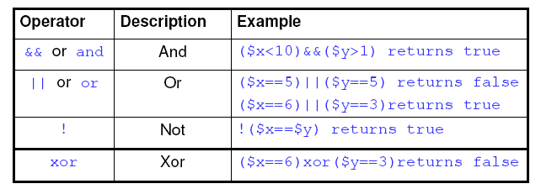
Logical Operators
Logical operators take Boolean (logical) values as operands and return a Boolean value.

Slide 50
Bitwise Operators
Allows you to turn specific bits within an integer on or off. If both the left and right hand parameters are strings, the bitwise operator will operate on the characters’ ASCII values.
E.g.
<html>
<body>
<?php
echo 12^9;
echo “12”^”9”;
?>
</body>
</html>
Notes:
See the output of the coding
//outputs “5”
//outputs the backspace character (ascii 8)
//(‘1’ (ascii 49)) ^ (‘9’ (ascii 57)) = #8

Slide 51
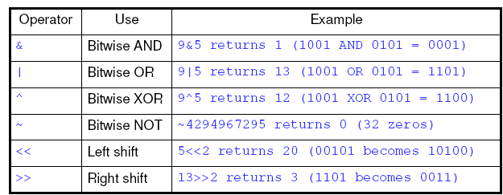
Bitwise Operators Continue…
Examples | Name | Result
$a & $b | AND | Bits that are set both $a and $b are set.
$a | $b | OR | Bits that are set in either $a or $b are set.
$a ^ $b | XOR | Bits that are set in $a or $b
~ $a | NOT | Bits that are set in $a are not set, and vice versa.
$a << $b | Shift Left | Shift the bits of $a, $b steps to the left. (each step means “multiply by two”)
$a >> $b | Shift Right | Shift the bits of $a, $b steps to the right. (each step means “divide by two”)
Notes:
Bitwise operators treat their operands as a set of bits (zeros and ones), rather than as decimal, hexadecimal, or octal numbers.

Slide 52
Constants
You must use the PHP’s define() functions to create a constant which is subsequently cannot be changed unless use separately define it again.
Syntax
define(“ your -constant-name” ,value);
E.g. define(“age”,25);

Slide 53
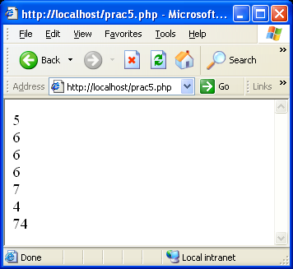
Exercise
<?PHP
$a = 5;
echo $a++,"<br>";
echo $a--,"<br>";
$b = 5;
echo ++$b,"<br>";
echo $b,"<br>";
$a += 2;
echo $a,"<br>";
$b -= 2;
echo $b,"<br>";
$sentence_c = $a . $b;
echo $sentence_c;
?>

Slide 54
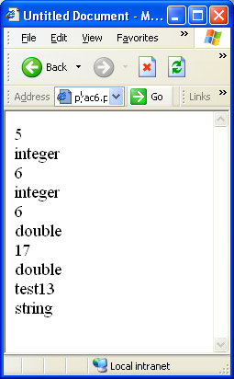
Exercise
<?php
$b = $a = 5;
$c = $a++;
echo $c,"<br>";
echo gettype($c),"<br>";
$e = $d = ++$b;
echo $e,"<br>";
echo gettype($e),"<br>";
$f = (double)($d++);//convert to another data type
echo $f,"<br>";
echo gettype($f),"<br>";
$g = (double)(++$e);
$h = $g += 10;
echo $h,"<br>";
echo gettype($h),"<br>";
$s="test";
$m = $s."13";
echo $m ,"<br>";
echo gettype($m),"<br>";
?>

